Slide 1
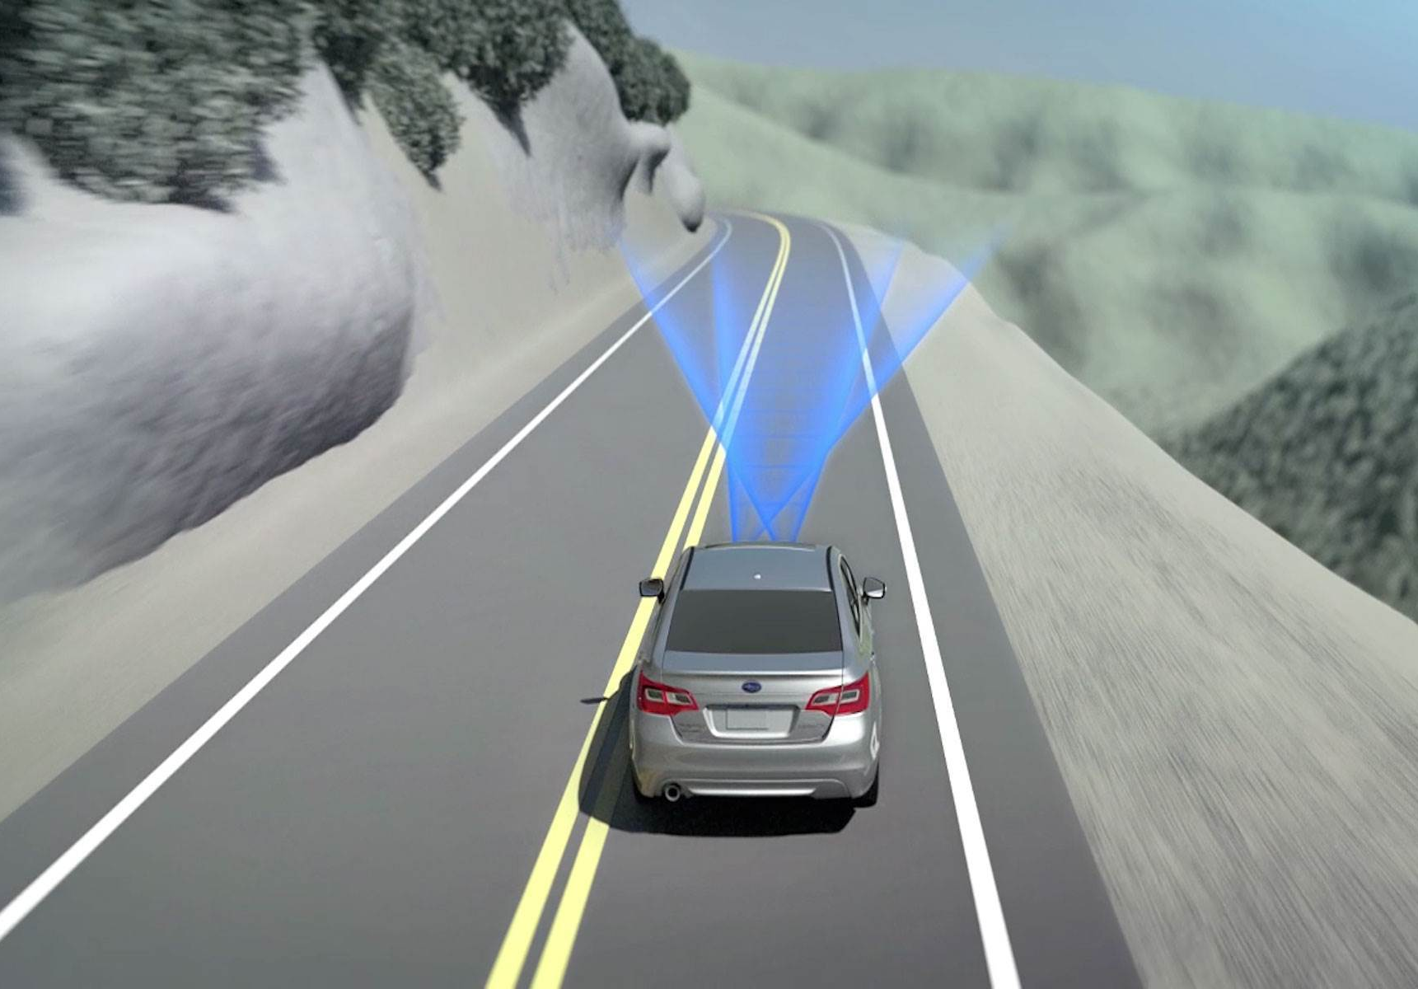

ARTIFICIAL INTELLIGENCE BITI 1113
Lanes Detection for Self Driving Car

Slide 2
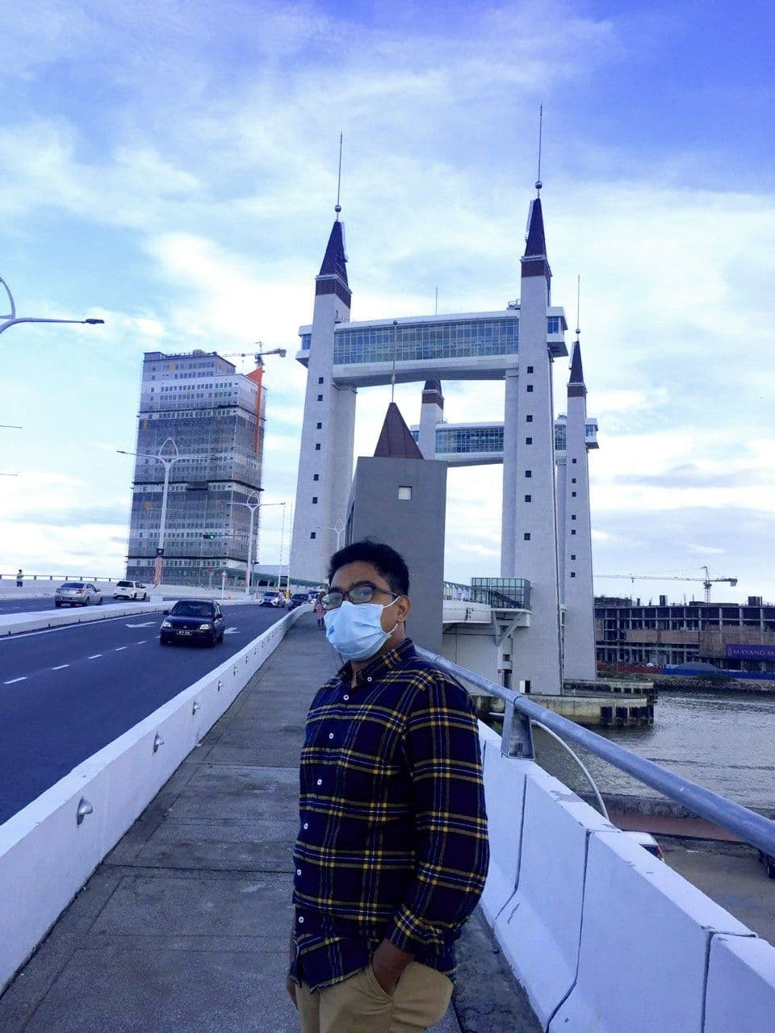
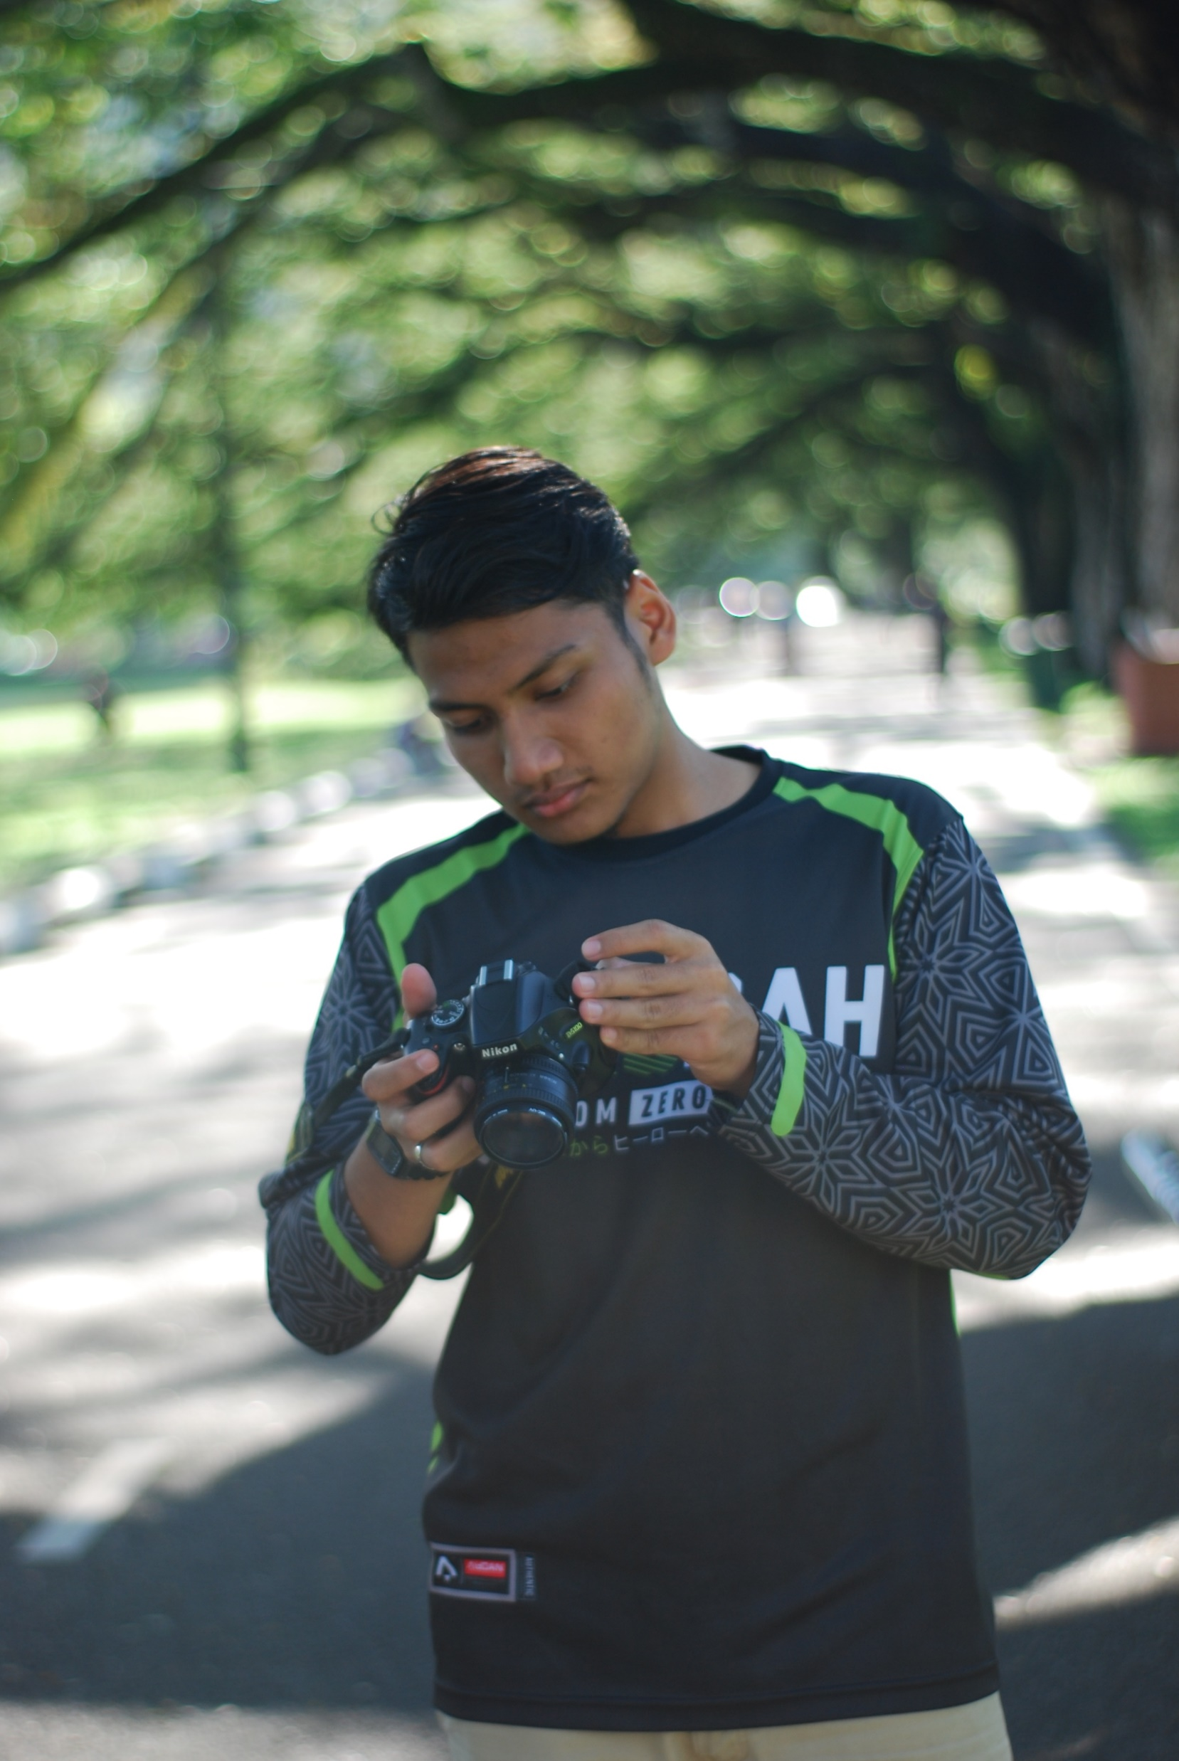
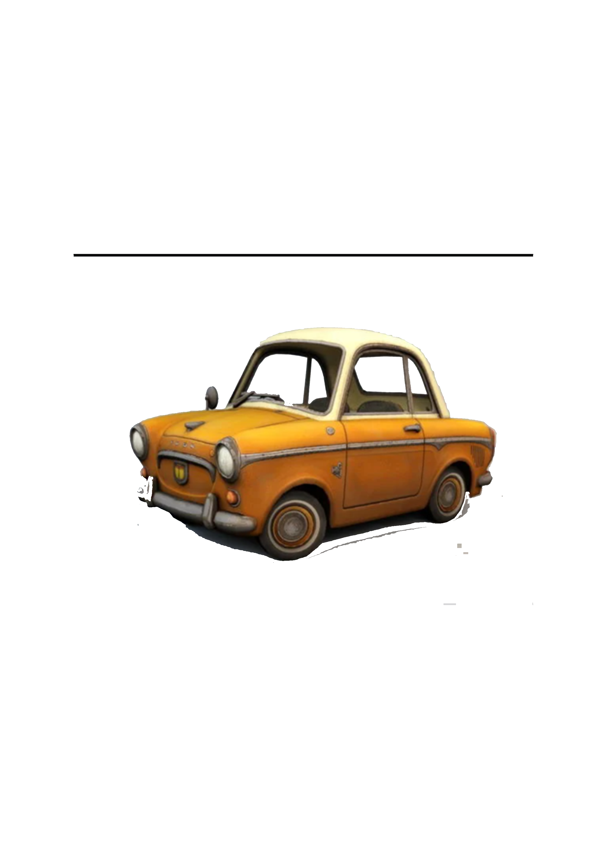

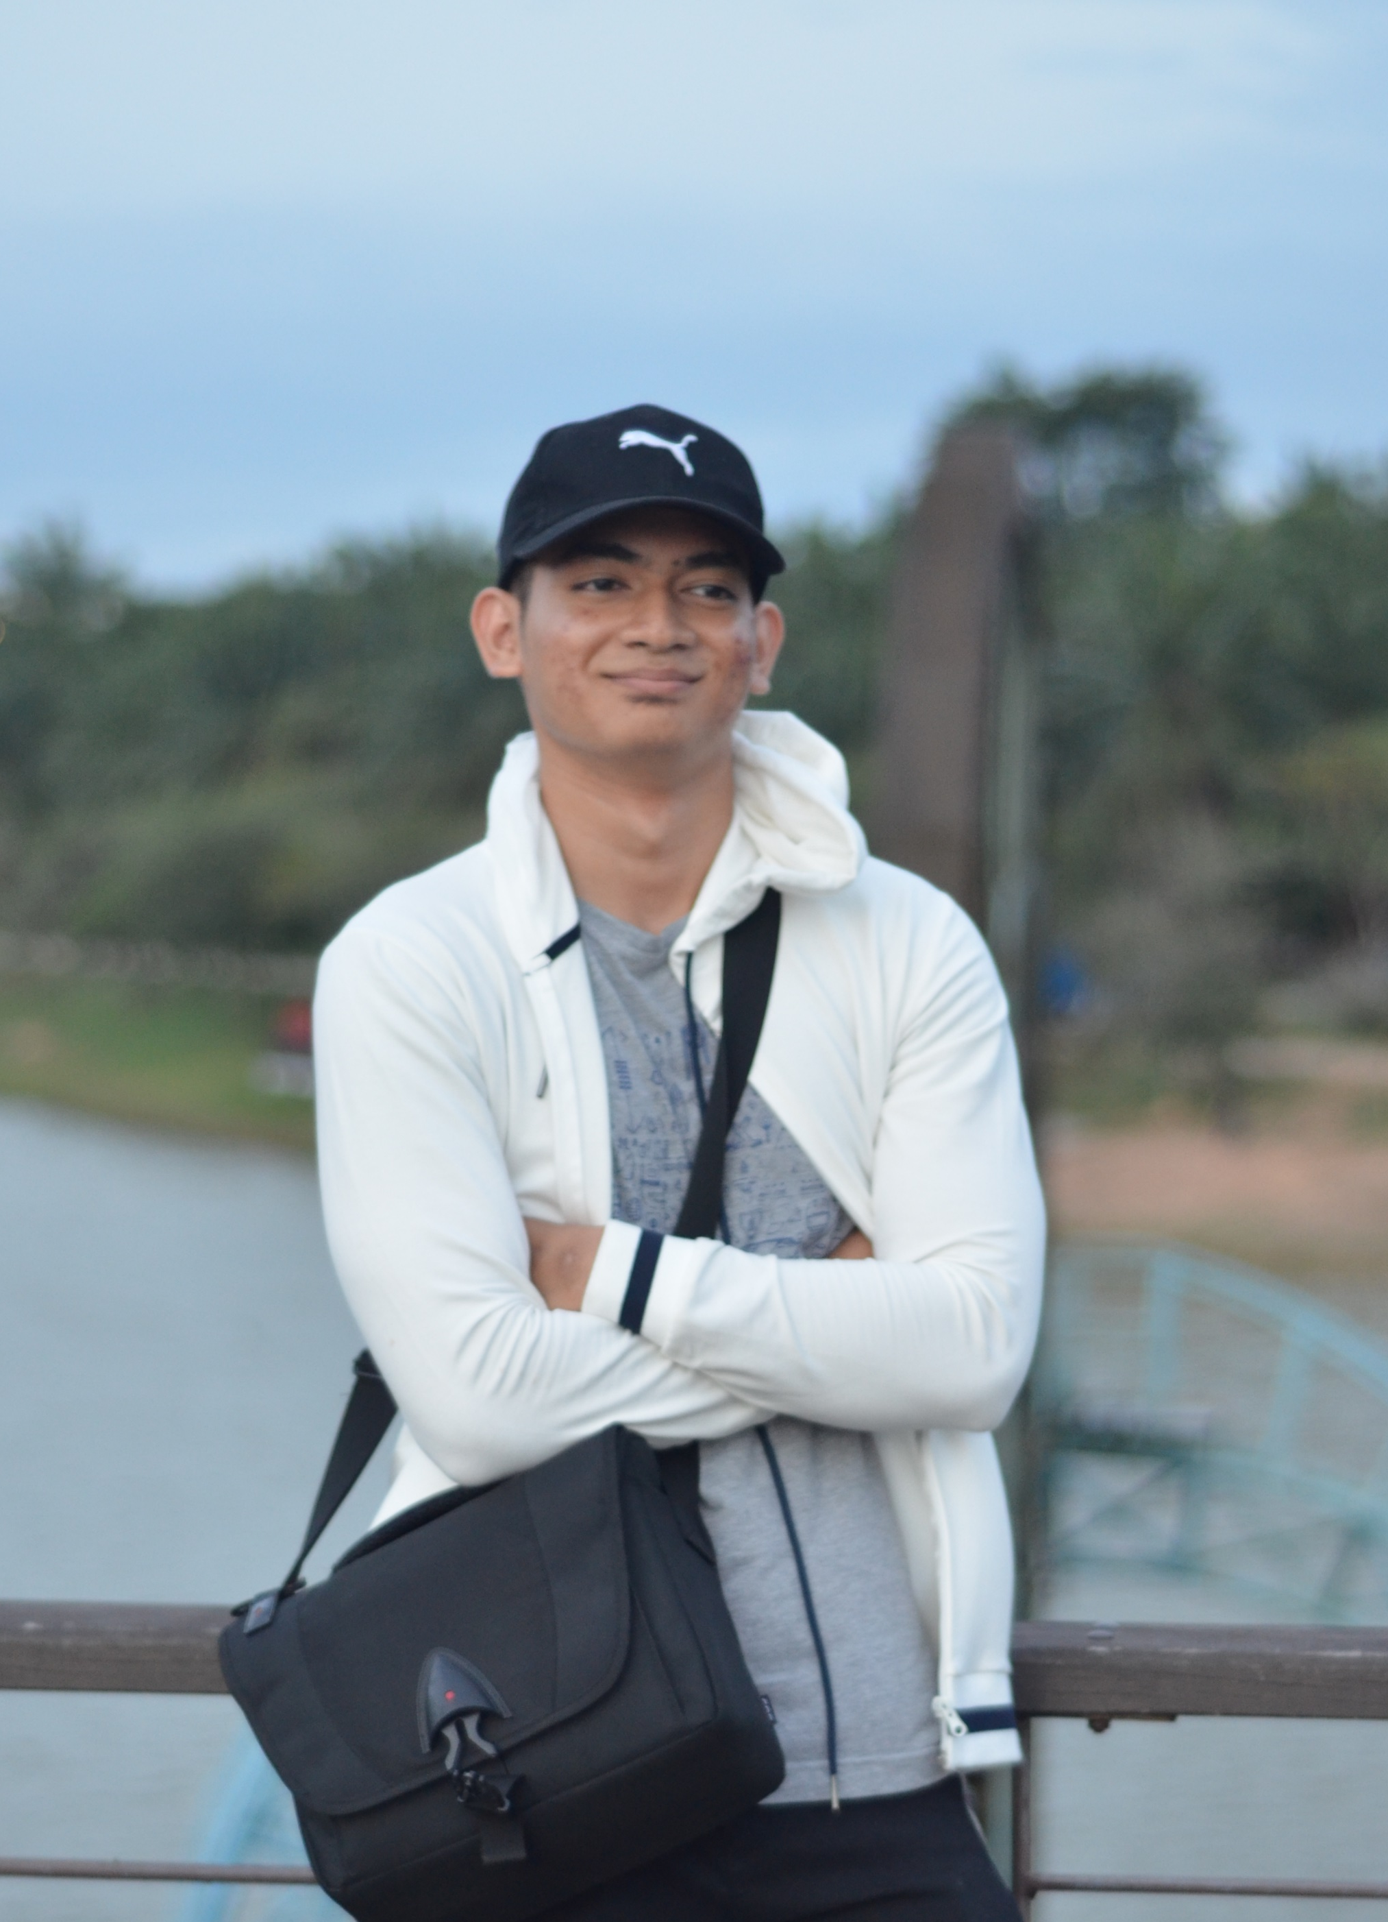
Group Members
Amirul Aizat Bin Rosli B031910118
Mohammad Syauqi bin Abdul latiff B031910393
Ahmad Firdaus bin Mohamad B031910133
Khairil Nur Azizie Bin Shafirudin B031910249

Slide 3
Objectives
Break out the project goal into more specific objectives
Minimize the road accident due to human error
Provide clearer vision to pick lane during driver if the weather is bad

Slide 4
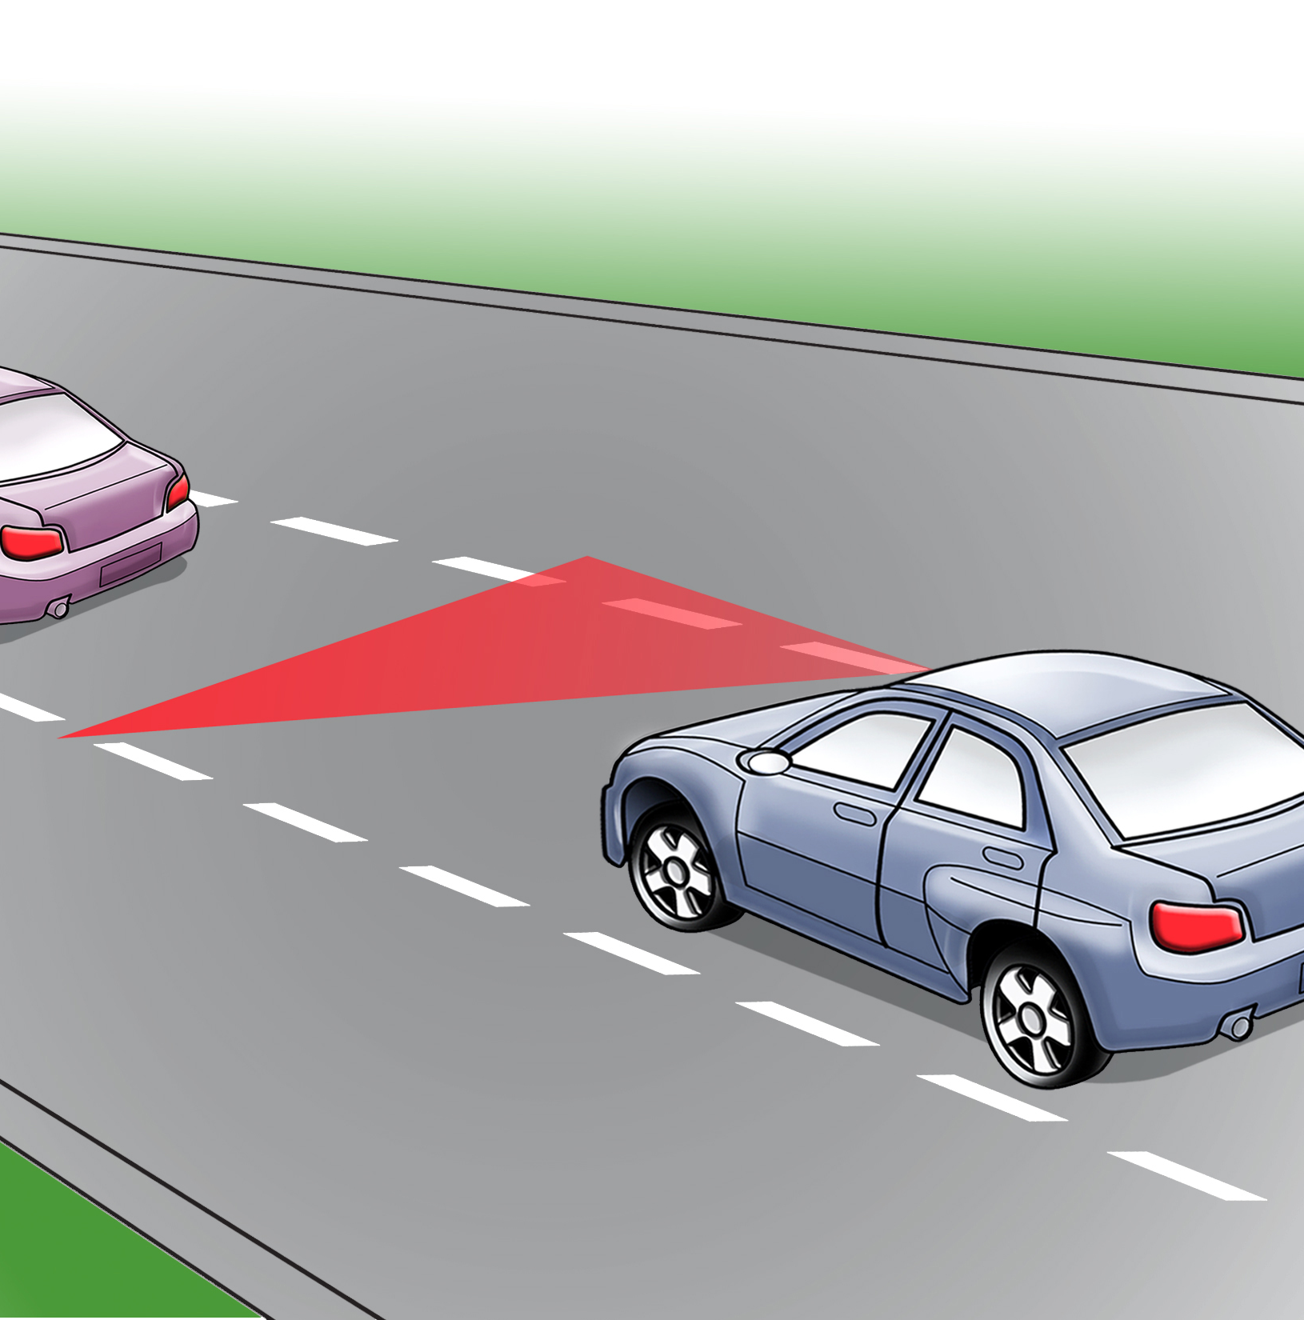
ABSTRACT
-> Detecting lane lines while driving on the road is a task for autonomous vehicles. Despite the fact that it appears to be a simple task, it is a critical component of the project. Lane line detection is a vehicle-based system that will assist and give a self-driving car system. It will maintain the automobile on track and assist the drivers with safe driving by employing image processing to do recognition on the road lane. The developer will do the machine training by using Neural Network technique to build the line detector and then build a system that detect lane lines in real-time. The project will need computer vision to do the detection and the available computer vision at the moment is OpenCV library.

Slide 5
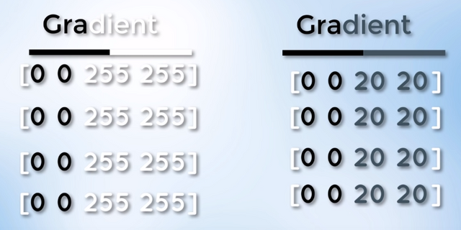
IMPLEMENTATION
2. Canny Edge Detection
-As the name imply, it is an algorithm to detect edges in our image.A change in intensity of pixel will gives us an edge.
Figure 3 show the code used in implementing the canny edge detection.
where blur represent blur image,
50 = low threshold ,150 = high treshold.
1.Gaussian Blur
Figure show the gradient use to detect road line on the road.The above image shows a Strong gradient on the left and a Weak Gradient on the right.

Slide 6
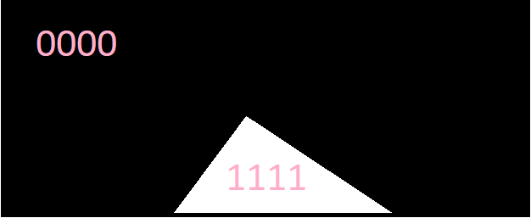
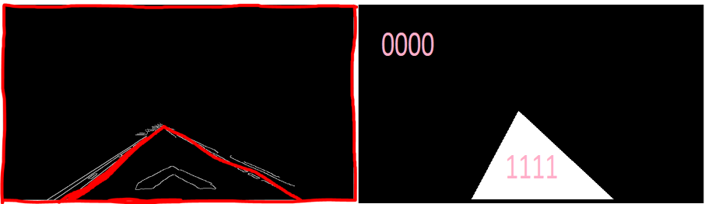
3. Hough Transform
-After detecting the edge in the image using technique above, we will use the technique call hough transform to detect the lane lines.But before that, we need to find region of interest in our image by using certain code.
once its done,we create a polygon over as shown
-0000 represents the black pixels and 11111111 represents the white pixels, denoting the polygon. Now, we apply the bitwise_and in the original image and the mask to obtain the masked_image, which essentially will contain only the region on interest.

Slide 7
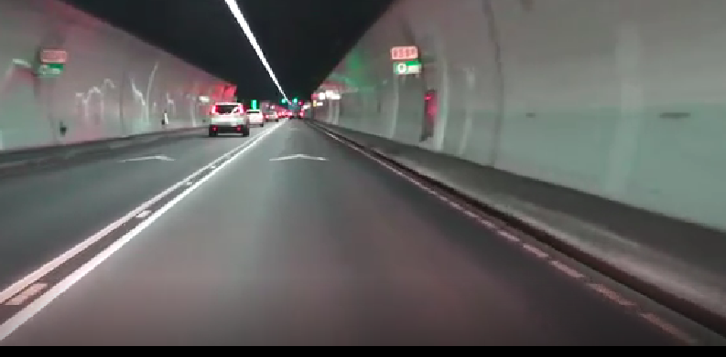
RESULT
-The result that we get by combining the hough transform and gaussian blur able to make the system detect and highlight the line in the road lane as shown in the image below.
From this:

Slide 8
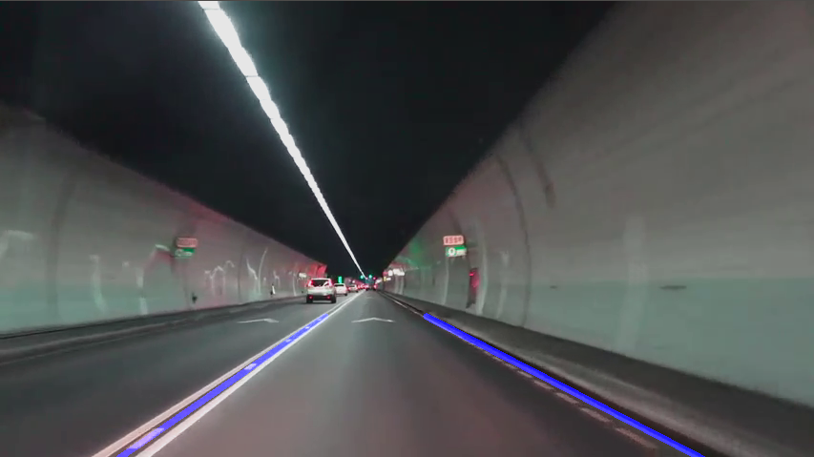
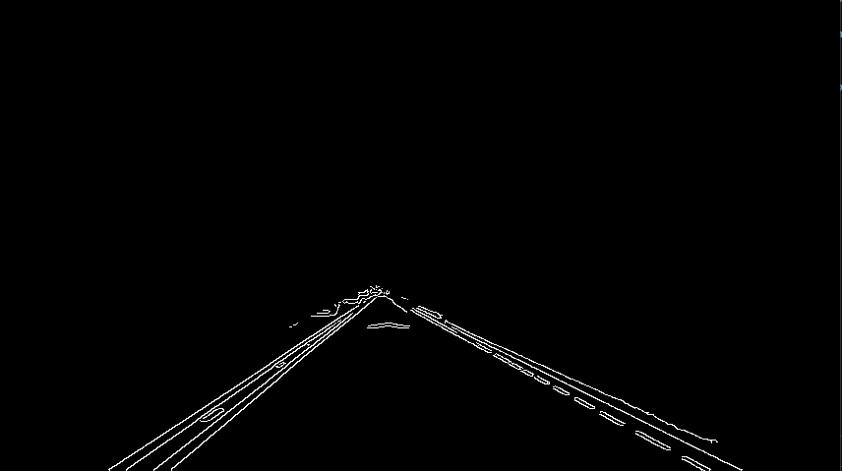
To this:

